Slide 1
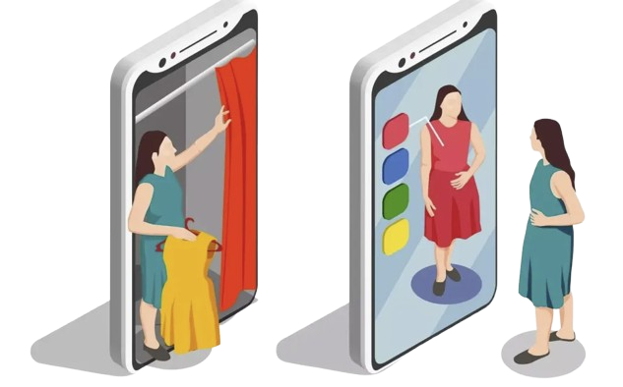
Caffeine Overflow’s
Project Proposal on
“Ai driven virtual try-on system in
E-commerce“
Aporbo Ghosh-1931458
Tasfia Anjum Zuairia- 2221233

Slide 2
Introduction
- What does an AI- driven virtual try-on system in E-commerce actually entail?
- Advanced Computer vision and Augmented Reality for enhanced experience
2

Slide 3
Literature Review
Increasing popularity in virtual try-on systems in e-commerce
Several research papers on virtual try- on technologies
The “Anyfit project”(generating realistic 3D models from 2D images)
One major issue - High Computational Complexity
3

Slide 4
Motivation
-Rapid growth of E-commerce in the retail industry
-The limitations of online shopping
-How virtual try-on system helps in solving these limitation
4

Slide 5
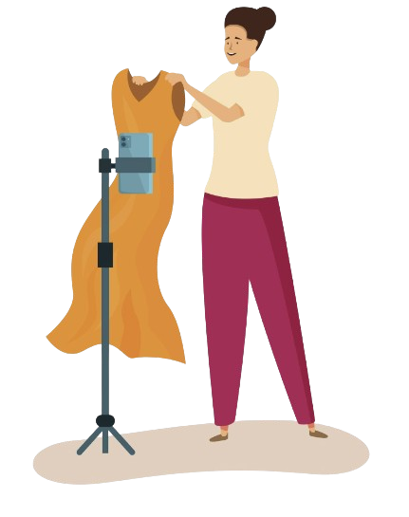
Goals
Main goal- visualization of clothes fitting as realistically as possible, by applying the following methods:
- Develop an AI-Driven Virtual Try-On Platform :
-Enhance Fit Accuracy Through Computer Vision:
-Provide Personalized Clothing Recommendations:
-Integrate Augmented Reality for Real-Time Interaction:
-Optimize User Experience:
5

Slide 6
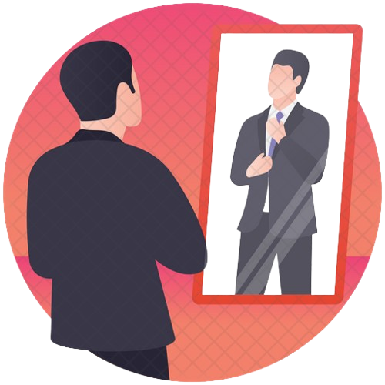
Applications in Real Life
Enhancing online shopping
Reducing returns and operational costs.
Personalized shopping experience.
6

Slide 7


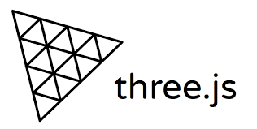

Tools Needed
-
-
OpenPose/DensePose
-
-
-
7

Slide 8
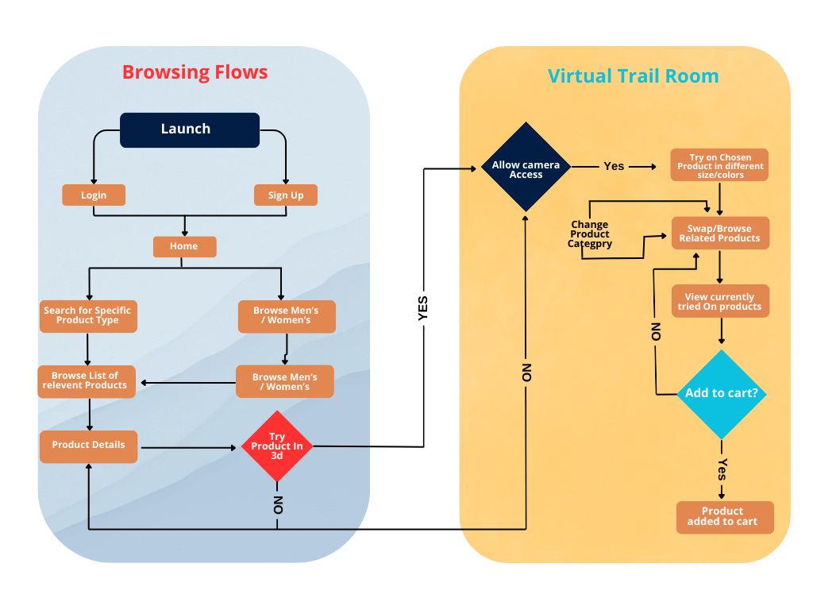
Schematic Diagram
8

Slide 9
Projected Timeline
Breakdown of project phases:
Week 1-2: Data collection, frontend setup.
Week 3-4: AI and 3D model development.
Week 5-6: AR and recommendation engine development.
Week 7-8: Testing and launch.
9

Slide 10
Conclusion
Summary of key benefits:
Personalized, interactive shopping experience.
Reduced product returns.
Better insights for retailers through data.
10

Slide 11
Thank
YOu
11

